Slide 1
Scientific Research - Methodologies and Techniques

Slide 2
SCIENTIFIC RESEARCH

Slide 3
Scientific Research
Involves investigation or experimentation aimed at
discovery and interpretation of facts,
revision of accepted theories or laws in the light of new facts, or
practical application of such new or revised theories or laws.
Involves collecting information about a particular subject.

Slide 4
SCIENTIFIC METHOD

Slide 5
Methodology
Methodology - the study of the methods involved in some field, endeavor, or in problem solving.
Some definitions:
“the analysis of the principles of methods, rules, and postulates employed by a discipline";
Refers to a collection of theories, concepts or ideas
"the systematic study of methods that are, can be, or have been applied within a discipline”, or "a particular procedure or set of procedures.”
Refers to critique of the individual methods
Methodology refers to more than a simple set of methods;
it refers to the rationale and the philosophical assumptions that underlie a particular study.
Often used as a substitute for method in scientific and technical contexts.

Slide 6
Method
Method – a systematic series of steps taken to complete a certain task or to reach a certain objective.
Description of methods in the abstracts of research papers:
E.g. 1: “In this paper the classification of requirements changes based on structure of a textual requirement is provided with formal semantics. The formalization of requirements relations and changes is used for propagating proposed changes and consistency checking of proposed changes in requirements models. The tool support for change impact analysis in requirements models is an extension of our Tool for Requirements Inferencing and Consistency Checking (TRIC).”
E.g. 2: “An automated solution for cutting a dendrogram that is based on least-squares regression is presented in order to find the best cut level. A dendrogram is a tree diagram that shows the taxonomic relationships of clusters of software entities. Moreover, a factor to penalize clusters that will form singletons is introduced in this paper. Simulations were performed on two open-source projects. The proposed approach was compared against the exhaustive and highest gap dendrogram cutting methods, as well as two well-known cluster validity indices, namely, Dunn’s index and the Davies-Bouldin index.”

Slide 7
Scientific Method
The “scientific method” attempts to minimize the influence of the researchers' bias on the outcome of an experiment.
The researcher may have a preference for one outcome or another, and it is important that this preference not bias the results or their interpretation.
Sometimes "common sense" and "logic" tempt us into believing that no test is needed.
E.g. Assume that the datasets used are normally distributed, thus ignore the normality test on the set of datasets.
Ignore data which do not support the hypothesis.
e.g. Ignore results having negative impact on the proposed approach.
There are several variants and each researcher needs to tune the process to the nature of the problem and his/her working methods.

Slide 8
In Systems Development: Method or Methodology?
Often taken to mean the same, but actually these terms differ.
Method = step-by-step description of the steps involved in doing a job.
No two projects are identical, so method is specific to one project.
Methodology = set of general principles that guide the choice of a method suited to a specific task or project.

Slide 9
In Systems Development: Method or Methodology?
Increasing level of abstraction
Example of application
Typical product
A specific version of the FoodCo class diagram
Task
Developing a first-cut class diagram for FoodCo
Technique
Description of how to carry out a technique, e.g. UML class modelling
Any UML class diagram
Method
Specific techniques used on a particular project (e.g. FoodCo use cases, class model, etc that lead to a specific product
FoodCo’s product costing system
Methodology
General selection and sequence of techniques capable of producing a range of software products
A range of object-oriented business applications

Slide 10
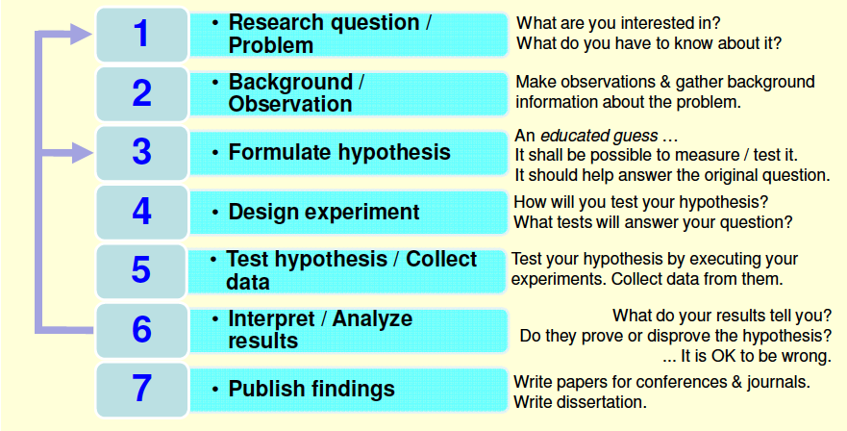
Overview of Research Methods – Classical phases

Slide 11
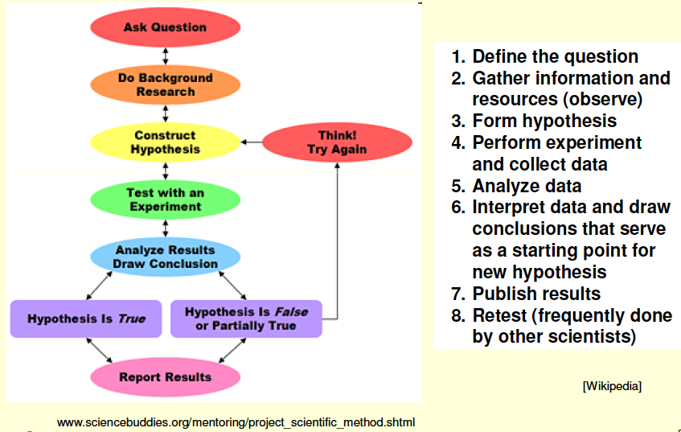
Research Methods – Other Variants

Slide 12
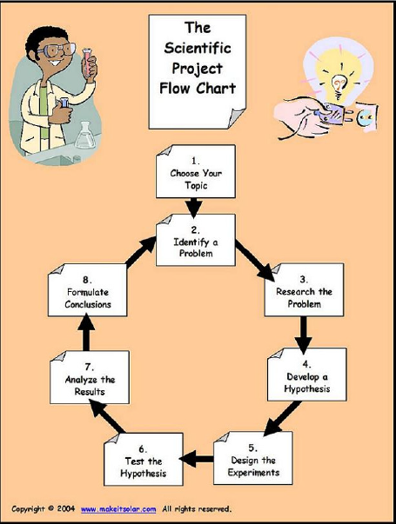

Slide 13
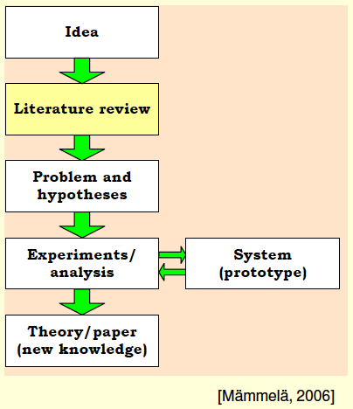
Experiments gained from knowledge of the literature

Slide 14
Observation - an act of recognizing and noting a fact or occurrence often involving measurement with instruments
1. Observation
2. Hypothesis
Test Hypothesis
False
4. Predictions
True
3. Testing
If the experiments prove the hypothesis to be true, it becomes a theory or law of nature. If the experiments prove the hypothesis to be false, the hypothesis must be rejected or modified. The scientific method used properly should give us predictive power (to understand phenomena which have not been tested).
Further reading found at http://teacher.nsrl.rochester.edu/phy_labs/AppendixE/AppendixE.html

Slide 15
Steps of the Scientific Method
Step 1: Formulate Research question / Problem
The most important step in research
Examples:
1 single question:
“Which methods and tools should be developed to make current manufacturing control / supervision systems reusable and swiftly modifiable?”
Multiple questions:
Q1: What are the main components of logistics costs that determine the logistics and transport network design?
Q2: To what extent are the existing network design and evaluation models sufficient and how can collaboration be incorporated in the network design methodology?
Q3: How can economies of scale and scope, present in the network, be taken into account in the network design?
Q4: Is it possible to set boundaries to the development path of the network, and search for a feasible path instead of searching solely for a feasible solution? (©L. M. Camarinha-Matos, 2009-2012)

Slide 16
Steps of the Scientific Method
Step 2: Background / Observation
How has the work been done previously? What similar work has been leading up to this point?
Study state of the art (literature review, projects, informal discussions, etc).
Sources: Encyclopedias, monographs, textbooks, review papers/tutorials, original papers (journals, conferences, symposia, workshops), and reports.
Optional realization of preliminary experiments.
What distinguishes previous work from what you want to do?
Who / What will be impacted by this research?
You may iterate between Step 2 and Step 1.

Slide 17
Steps of the Scientific Method
Step 3: Formulate hypothesis
A scientific hypothesis states the ‘predicted’ (educated guess) relationship amongst variables.
Serve to bring clarity, specificity and focus to a research problem
... But are not essential
... You can conduct valid research without constructing a hypothesis
... On the other hand you can construct as many hypothesis as appropriate
Stated in declarative form. Brief and up to the point.

Slide 18
Steps of the Scientific Method
Criteria of a good hypothesis
Simple, specific and conceptually clear.
ambiguity would make verification almost impossible.
Capable of verification.
There are methods and techniques for data collection and analysis.
Related to the existing body of knowledge.
Able to add to the existing knowledge.
Operationalisable
Expressed in terms that can be measured

Slide 19
Steps of the Scientific Method
The hypothesis shall contain two types of variables:
Independent Variable(s): the one the researcher controls.
It is what you, the researcher, change to cause a certain effect.
Dependent Variable(s): the one you measure or observe.
It’s the effect of the researcher’s change.
E.g. “If skin cancer (DV) is related to ultraviolet light (IV), then people with a high exposure to UV light will have a higher frequency of skin cancer.”
E.g. “If temperature (IV) affects leaf color change (DV), then exposing the plant to low temperatures will result in changes in leaf color.”

Slide 20
Steps of the Scientific Method
Step 4: Design experiment
Includes planning in detail all the steps of the experimental phase.
In engineering/CS research it often includes the design of a prototype / system architecture.
Identify the variables that will be manipulated and measured - the research outcomes must be measurable.
What needs to be controlled in order to get an umbiased answer to the research question.
Therefore: it is necessary to not only design a prototype / system but also the thesis validation method.
How to validate the thesis?
The plan should allow others to repeat it.
It should be feasible...!
Plan intermediate milestones.

Slide 21
Steps of the Scientific Method
Step 5: Test hypothesis / Collect data / Perform Experiment
Implementation of methods (e.g. prototyping) and auxiliary tools (e.g. simulation)
Pilot testing and refinement.
Field vs. Laboratory work.
Ethical considerations.
Confirm results by retesting.

Slide 22
Steps of the Scientific Method
Step 6: Interpret / Analyze results
What did your experiment show?
Quantitative data analysis.
Descriptive and inferential statistics, clustering, ...
What might weaken your confidence in the results?
Discussion regarding
Literature
Research objectives
Research questions.
Consider next steps
Recommendations for further research.

Slide 23
Steps of the Scientific Method
Step 7: Publish findings
A research result is not a contribution to the field if no one knows about it or can use it.
Write scientific papers, make presentations
Intermediate results
Conferences
Collect feedback
Consolidated results
Journals
Be careful in selecting where you publish.
Reviewed? Indexed?
Science Citation Index? Web of Science?
Sponsors?
IEEE? IFIP? IFAC?
Write dissertation

Slide 24
Other Related Issues
Proof of Concept or “Proof of Principle” [as in Wikipedia]
A short and/or incomplete realization of a certain method or idea(s) to demonstrate its feasibility, or
a demonstration in principle, whose purpose is to verify that some concept or theory is capable of exploitation in a useful manner.
In applied research, a company presented with a project or proposal will often undertake internal research initially, to prove that the core ideas are workable and feasible, before going further.
This use of proof of concept helps establish viability, technical issues, and overall direction, as well as providing feedback for budgeting and other forms of commercial discussion and control.

Slide 25
INQUIRY METHODS IN RESEARCH

Slide 26
Inquiry Methods in Research
Main inquiry methods guide a researcher to solve problems and find answers to questions in research:
Positivist method (used in quantitative research)
Interpretative method (used in qualitative research)
Critical method (used in qualitative research)

Slide 27
Positivist Method
Through numerical analysis, positivist method emphasises the accuracy of research evidence.
Generally regarded as quantitative research.
Experimental research and survey are among the many methods used by positivist researchers.
Studies are conducted to:
make predictions using methods to identify, measure and state accurately relationships among the variables being studied in a phenomenon.
The positivist research:
forms hypotheses about relationships between variables in the study;
tests the relationships on subjects randomly selected from a target population;
Obtains results after undergoing rigorous statistical analysis will be generalised to all subjects in that population.

Slide 28
Positivist Method
E.g. to identify factors of unemployment among male graduates of a tertiary institution:
will study one sample which is randomly chosen from that population of male graduates there;
then factors identified for study can then be generalised to all male graduates of that population;
Report quantitative values representing the factors which are responsible for the unemployment, such as:
Frequency, percentage, mean and standard deviation of male graduates who are unemployed

Slide 29
Interpretative Method
Explains a phenomenon by using verbal descriptive data.
Analysis of verbal descriptive data is emphasised.
Generally regarded as qualitative research.
Field research is one of the most frequent types of studies.
Collects data through observation and interviews.
This type of research usually examines in depth the characteristics of a small group of subjects.
E.g. a study to identify the work style of a group of company managers who have been identified as excellent leaders.
Qualitative data from interviews with managers is more important to the researcher.

Slide 30
Critical Method
Used to improve the social conditions of mankind.
Generally regarded as qualitative research.
Attempts to understand the relationships among social groups, and how social differentiation is created.
Use existing historical sources and secondary data as the bases of their comparative studies.
Research findings will be considered valid if they can be applied to improve the social situation.

Slide 31
Quantitative and Qualitative Research
Different in terms of the methods and techniques used.
Have different objectives, concepts, research designs, methods of sampling, collecting data and data analysis, and instrumentation.

Slide 32
Quantitative and Qualitative Research
Characteristics | Quantitative Research | Qualitative Research
Method | Positivist method Numerical data Experimental Statistic test Survey Correlation studies Comparative studies | Interpretative method Verbal data Explanatory Field research Historical research Case study Data triangulation
Main concept | Variables Operational definition of terms Hypothesis testing Measurement scales Validity and reliability Significance | Meaning Essay Understanding Phenomenon formation Context Triangulation In depth data

Slide 33
Quantitative and Qualitative Research
Characteristics | Quantitative Research | Qualitative Research
Field of study | Basic sciences Engineering Technology industry Psychology Political science Economics Accountancy Education | Anthropology History Sociology Social sciences Linguistics Literature Ethnography Arts
Objective | Test theory Build facts Demonstrate differences Demonstrate relationships Predict behaviour Explain an event statististically | Complete a theory Increase understanding Explain facts State a natural phenomenon Explain a phenomenon verbally

Slide 34
Quantitative and Qualitative Research
Characteristics | Quantitative Research | Qualitative Research
Research design | Experimental Quasi-experimental Non-experimental | Narrative Grounded theory Phenomenological Case study Content analysis
Population and sample | Big size sample Probability sampling method Random selection | Small size subjects Non-probability sampling Purposive selection
Data collecting instrument format | Formal Specific Structured Fixed Using scales | Informal and more flexible Non-structured Not determined Subjective

Slide 35
Quantitative and Qualitative Research
Characteristics | Quantitative Research | Qualitative Research
Item in research instrument | Many items Items contain suggested choices for selection | Few items Non suggested answers Open-ended
Data collection | Questionnaire Structured observation Structured interview | Non-structured observation Non-structured interview Documentation
Data | Quantity Number Types of measurement scales Statistics Compute Raw or standardised data Normality of data | Descriptive explanation Note on views Verbal notes Recording of observation or interview Information from documented materials Transcript

Slide 36
Quantitative and Qualitative Research
Characteristics | Quantitative Research | Qualitative Research
Data analysis | Descriptive statistics Inferential statistics Parametric tests Non-parametric tests | Long term Domain analysis Taxonomy analysis Hermeneutical analysis (i.e. interpretative or explanatory) Coding Themes
Potential of results being generalised | High | Low

Slide 37
Quantitative Research
Discrete number – associate with numerical data and accuracy.
Based on positivist research method where experimental research is conducted to collect numerical data, which are then analysed using statistical tests.
A research problem is stated in the form of hypothesis:
variables are defined – to be measured (studied).
Measurements prioritise validity and reliability in order to test theories, build facts and state the relationship among the variables under investigation.

Slide 38
Quantitative Research
Can also conducted using descriptive or inferential studies.
In descriptive studies: data is collected from an entire population and basic statistics such as frequency, percentage, mean, standard deviation and distribution score are reported.
In inferential studies: one sample is randomly chosen from the population being studied, numerical data is collected from the sample and hypothesis is tested using statistical tests.
The results obtained from the sample will be generalised to its population.

Slide 39
Quantitative Research
Descriptive study | Inferential study
Doesn’t use research samples. Respondents comprise all subjects in a population. Significance test is not needed. Uses descriptive statistics such as frequency, mean, percentage, variance, etc. Results of the study only apply to subjects which are being studied. Results of the study will not be generalised to other groups. | Respondents are subjects chosen from a population. Sample should be randomly selected to be representative of the population. Inference tests are used to analyse data collected from the subjects, such as t-test, and ANOVA among others, are used. Type I and II errors (i.e. false positive – incorrect rejection of a true null hypothesis; and false negative – failure to reject a false null hypothesis) should be controlled to ensure validity of the study. Test results derived from the subjects in the sample are generalised to all subjects in the population.

Slide 40
Qualitative Research
Explain phenomena in the real world that can’t be explained by numerical data (quantitative data) produced by quantitative research, e.g.
Intentions of a student who frequently plays truant;
Motives of an engineer who furthers his studies in the field of psychology;
Qualitative data collected through interviews and in-depth observation methods.
These methods are more appropriate for investigating individual or group phenomena that involve emotions, motivation, empathy, which can’t be fully captured by the numbers from a quantitative study.

Slide 41
Qualitative Research
Non-structured interviews, observations and questionnaires in the form of essays are the most common ways of collecting data in a qualitative research.
When the sample size in a qualitative research is small (sometime involves only one respondent), data triangulation is used to improve the reliability of the research.

Slide 42
Qualitative Research
Triangulation technique/method:
A phenomenon is viewed from different perspectives, with each perspective detected by using a different method.
Each method is directed to the same destination and focuses on the same event or phenomenon.
Helps a researcher to gain an in-depth understanding and more accurate view of the phenomenon under investigation.
To study a phenomenon (e.g. to measure one concept, i.e. a characteristic of the phenomenon), data can be collected through 3 different aspects (to ensure the results of the qualitative research will have a high level of validity and reliability), which are:
Time – data is collected at different times
Space – data is collected in different settings and locations
Individual – data is collected by different individuals.

Slide 43
References
Sources from “The Research Question and Hypothesis – Ryersion University”
“RESEARCH HYPOTHESES AND QUESTIONS”, Copyright 2003 by L. K. Curda, University of West Florida.
http://www.gobookee.net/ppt-of-scientific-research-methodology
Hong, L. Y. (2005). RESEARCH METHODS IN ENGINEERING AND SCIENCE. [http://www.wabri.org.au/postgrads/documents/RM%20sci_eng_notes/Eng_Leung.pdf]
Nordgren, (2004). The Scientific Method [http://newton.uor.edu/FacultyFolder/tyler%5Fnordgren/SP2004/Physics103_2.ppt]
Chua Yan Piaw, “Mastering Research Methods”, McGraw Hill, 2012.
http://teacher.pas.rochester.edu/phy_labs/appendixe/appendixe.html

